Slide 1



Cross sections update from GSI 2021 data
Giacomo Ubaldi
XIII FOOT Collaboration Meeting, Perugia
13/12/2022
Notes:
0-65k si
sincronizzazione persa intorno a 65k
in qualche punto tra 85k-90k recuperato e mantenuto fino ai 195k
tra 195k e 200k sincro persa fino a 455k,
sincro recuperata in un punto intorno al 460k e mantenuta fino a circa 555k
sincro persa tra 555k e 565k e persa fino alla fine

Slide 2


GSI 2021 Analysis
Data-taking at GSI (Darmstadt, Germany) in 2021
¹⁶O 400 MeV/u on 5 mm C target
Partial setup: no magnet, only one module of calorimeter
TW
MSD
BM
VTX
SC
CALO
TGT
My analysis goal:
Elemental fragmentation cross section measurements
Angular differential cross section measurements for every charge
1
XIII FOOT Collaboration Meeting
Giacomo Ubaldi

Slide 3
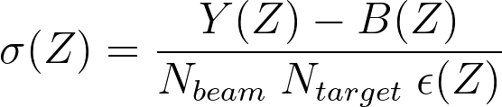
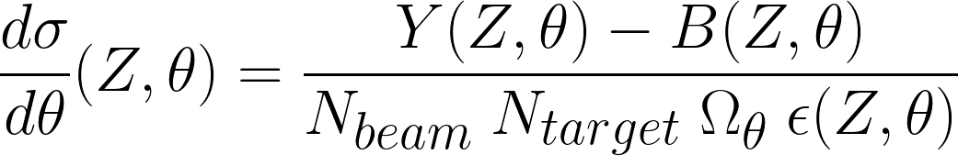
Analysis procedure
To compute elemental cross section and angular differential cross section:
Y: fragment counts
Bkg: background source counts
N_{beam}: n° of primary events
N_{target}: n° of scattering centers per unit area
ε: efficiency
Ω_{ϑ}: angular phase space
Event reconstruction in SHOE with Global Tracking
Analysis procedure in Python code
2
XIII FOOT Collaboration Meeting
Giacomo Ubaldi

Slide 4
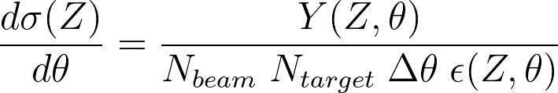
Analysis procedure
Starting from a MC dataset of 10⁶ events generated
by FLUKA to simulate detectors and beams
of GSI 2021 campaign.
3
XIII FOOT Collaboration Meeting
Giacomo Ubaldi

Slide 5
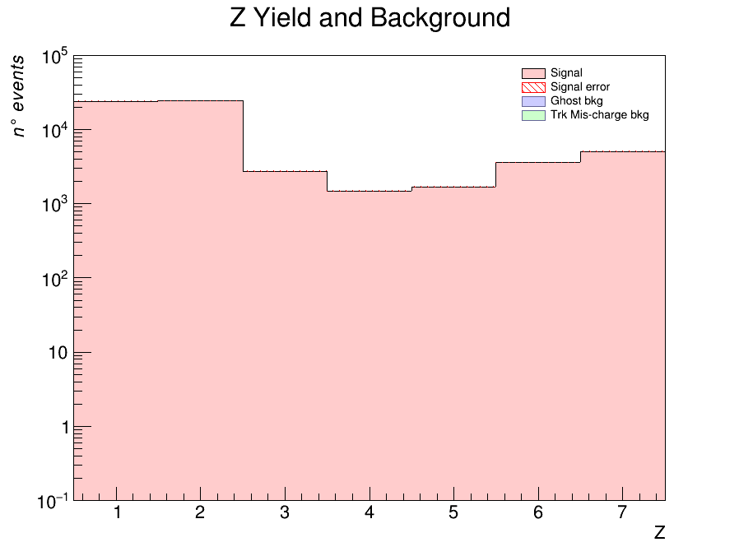
Analysis procedure
Starting from a MC dataset of 10⁶ events generated
by FLUKA to simulate detectors and beams
of GSI 2021 campaign.
Z yield and Bkg sources
2)Yield of Z obtained from reconstructed tracks
    Exploiting tracking reconstruction algorithm
    Simulating a “trigger” in order to consider
    only fragments
3
XIII FOOT Collaboration Meeting
Giacomo Ubaldi

Slide 6
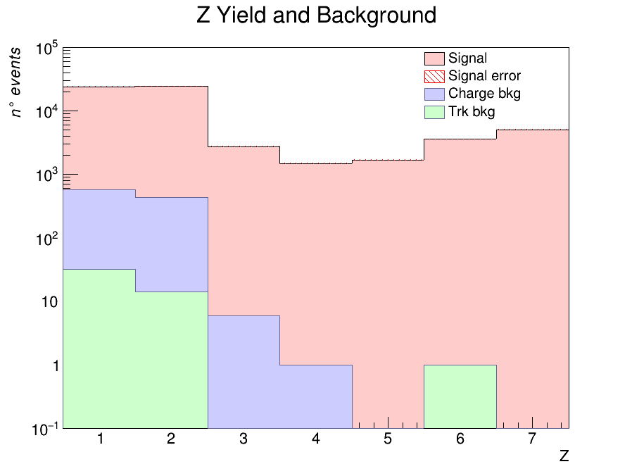
Analysis procedure
Starting from a MC dataset of 10⁶ events generated
by FLUKA to simulate detectors and beams
of GSI 2021 campaign.
Z yield and Bkg sources
2)Yield of Z obtained from reconstructed tracks
    Exploiting tracking reconstruction algorithm
    Simulating a “trigger” in order to consider
    only fragments
3)Background obtained from MC cuts on:
    Charge algorithm mis-reconstruction
    Tracking algorithm mis-reconstruction
3
XIII FOOT Collaboration Meeting
Giacomo Ubaldi

Slide 7
Implementation of Unfolding
( )^{U}
Unfolding accomplish for events migration effect between bins and total efficiency correction.
y_{i} = M_{ij} x_{j}
Reconstructed
distribution
Unspoiled
distribution
Migration
matrix
4
Giacomo Ubaldi

Slide 8
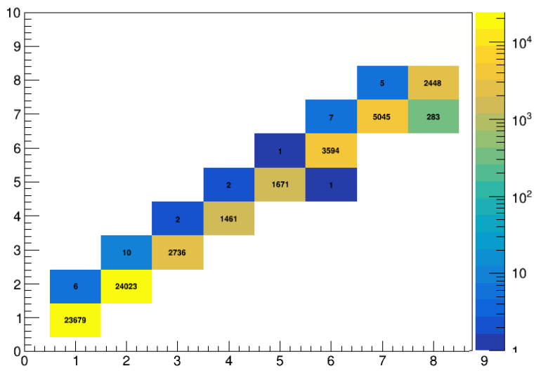
Implementation of Unfolding
( )^{U}
Unfolding accomplish for events migration effect between bins and total efficiency correction.
y_{i} = M_{ij} x_{j}
Reconstructed
distribution
Unspoiled
distribution
Migration
matrix
4
Giacomo Ubaldi

Slide 9
Implementation of Unfolding
( )^{U}
Unfolding accomplish for events migration effect between bins and total efficiency correction.
y_{i} = M_{ij} x_{j}
Reconstructed
distribution
Unspoiled
distribution
Migration
matrix
4
Giacomo Ubaldi

Slide 10
Implementation of Unfolding
( )^{U}
Unfolding accomplish for events migration effect between bins and total efficiency correction.
y_{i} = M_{ij} x_{j}
Then:
Reconstructed
distribution
Unspoiled
distribution
x_{j} = M_{ij}⁻¹ y_{i}
Migration
matrix
Application of
RooUnfold library
4
Giacomo Ubaldi

Slide 11
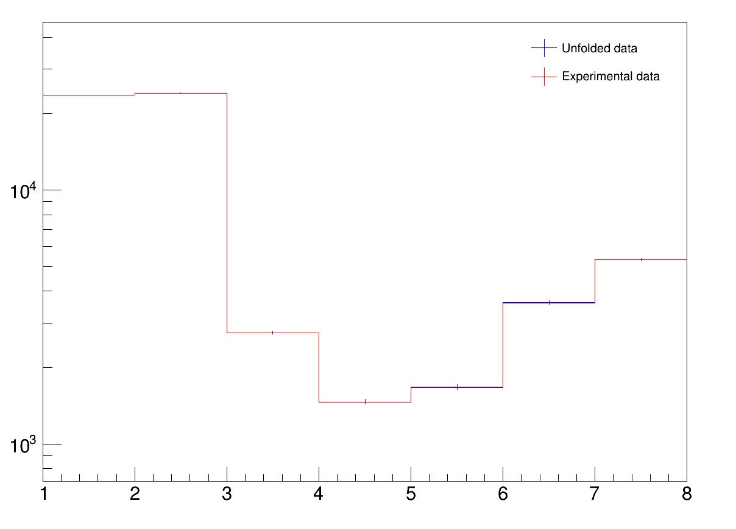
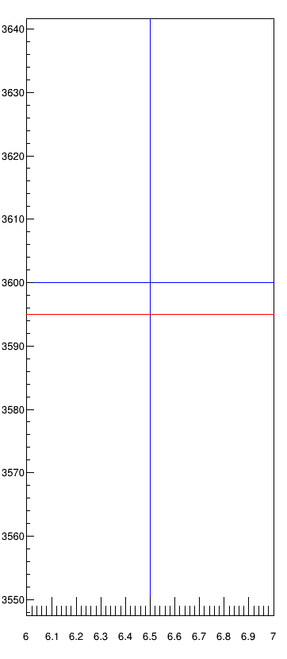
Implementation of Unfolding
( )^{U}
y_{i} = M_{ij} x_{j}
x_{j} = M_{ij}⁻¹ y_{i}
Little variation
because the migration
matrix is very diagonal
5
XIII FOOT Collaboration Meeting
Giacomo Ubaldi

Slide 12
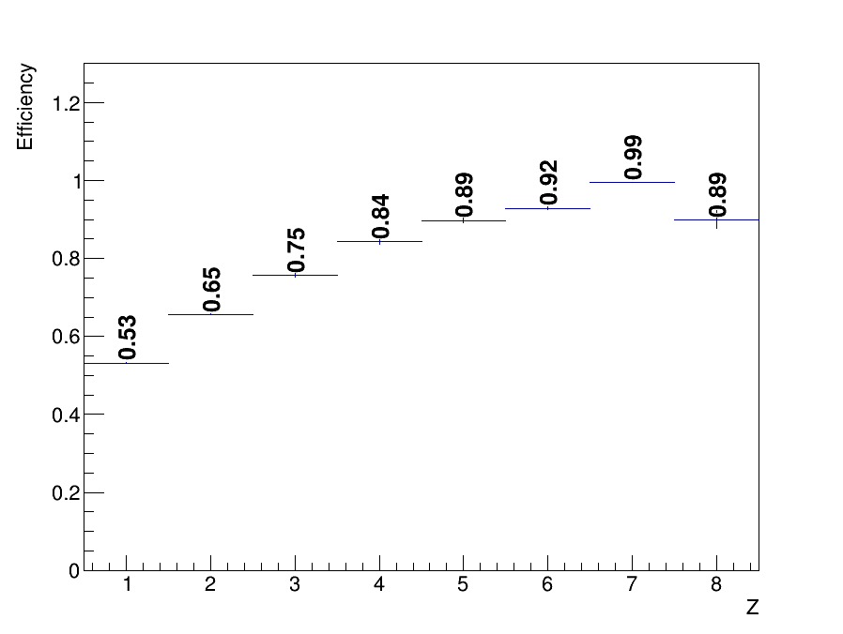
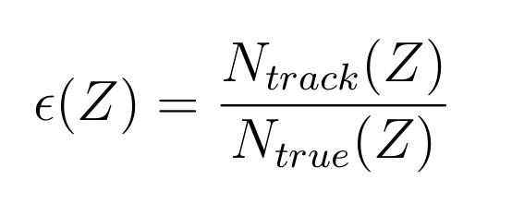
Analysis procedure
4) Track efficiency obtained as:
where
N_{track} is obtained by tracking algorithm
N_{true} are generated particles from the simulation
with angular acceptance θ≤8°
6
XIII FOOT Collaboration Meeting
Giacomo Ubaldi

Slide 13
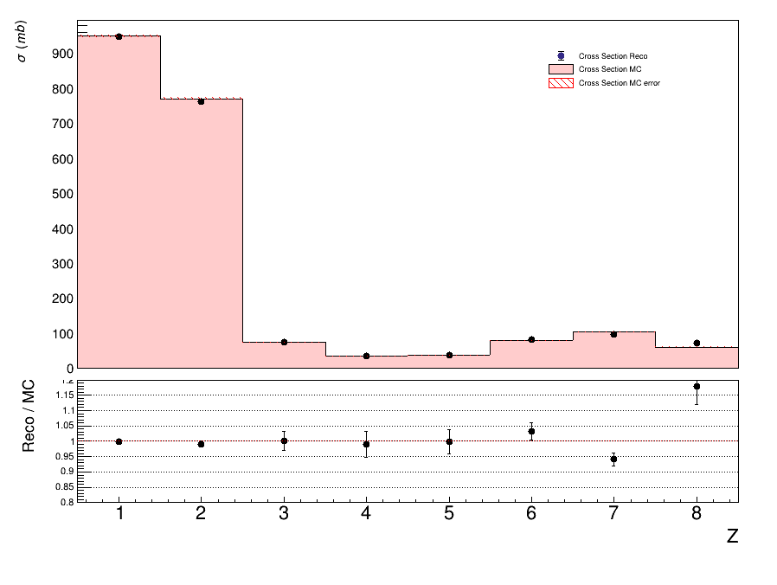
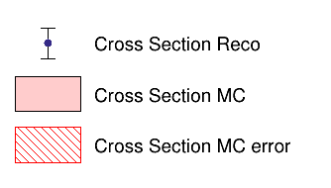
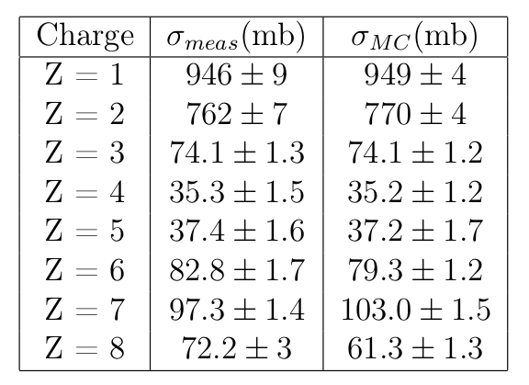

MC Closure test - elemental cross section
Fiducial (θ≤8°) elemental cross section
Only statistical errors
comparing the MC data-like cross sections with the MC generated ones.
understand the reliability of the analysis chain and algorithms ➔ solid analysis
1.2
1
0.8
7
XIII FOOT Collaboration Meeting
Giacomo Ubaldi

Slide 14
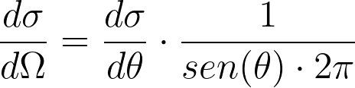
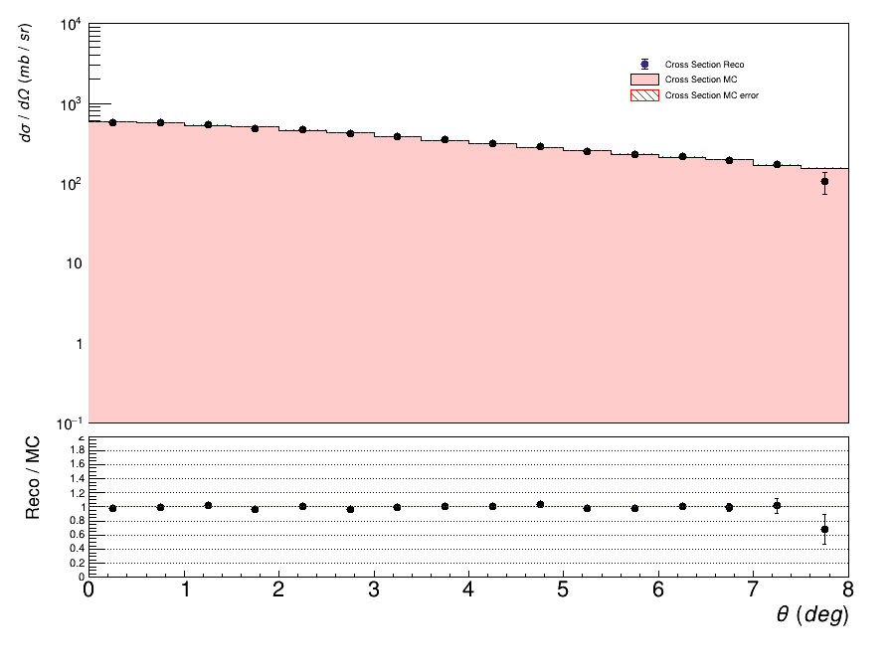
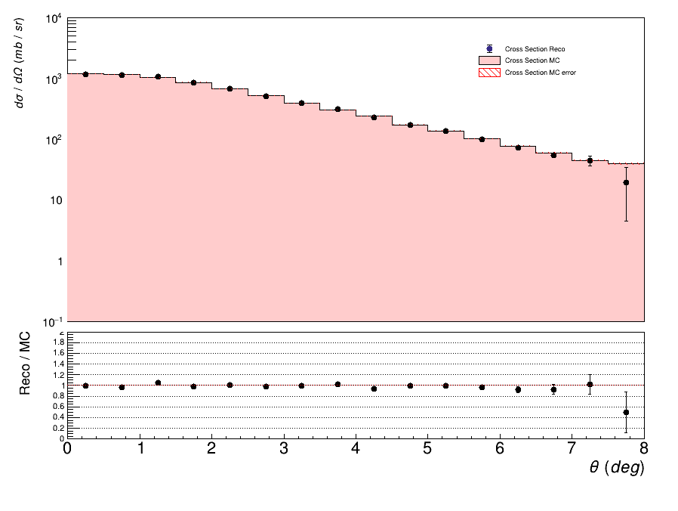
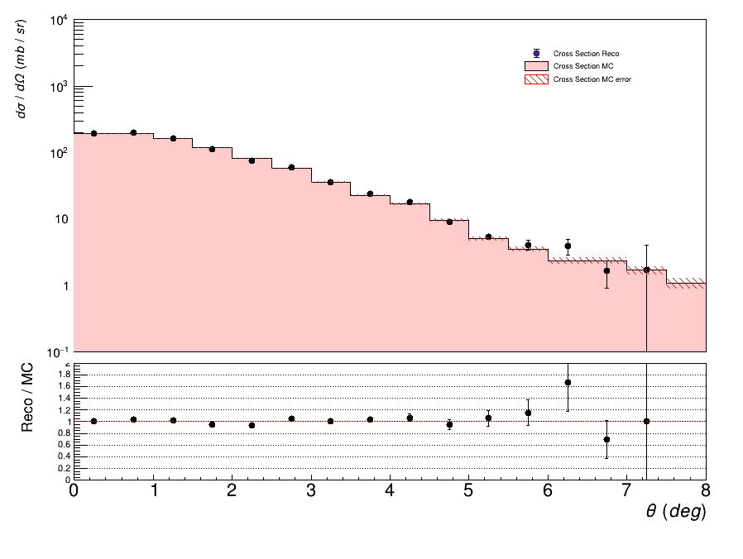


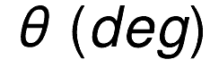
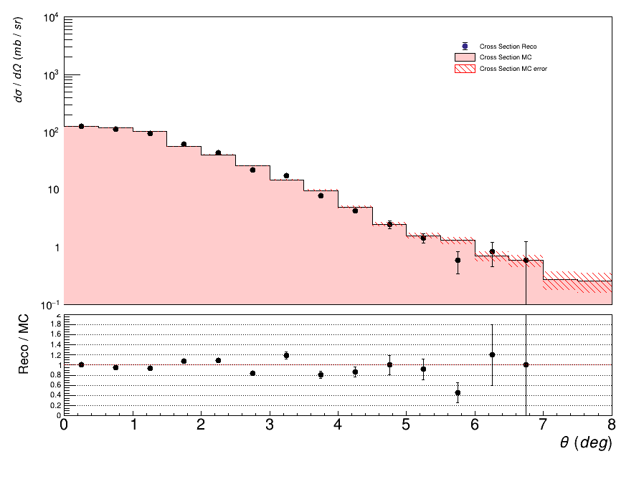
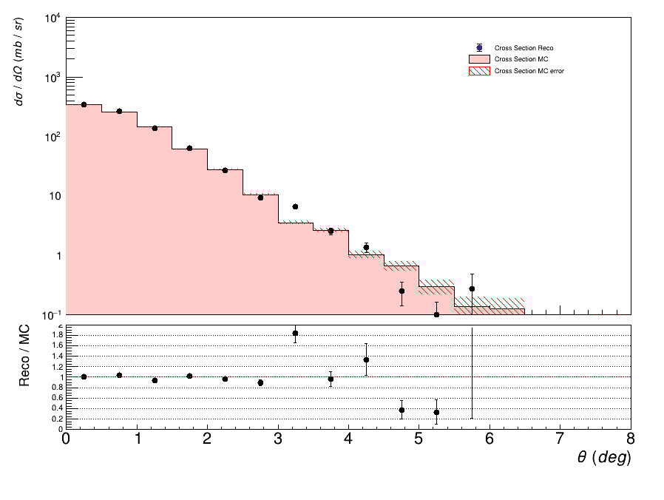
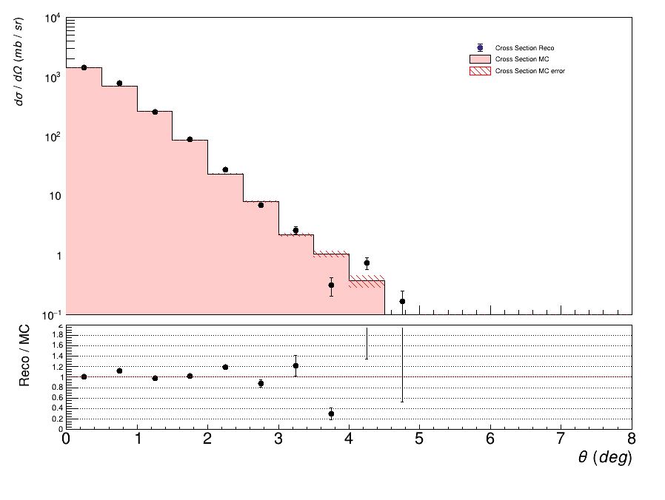
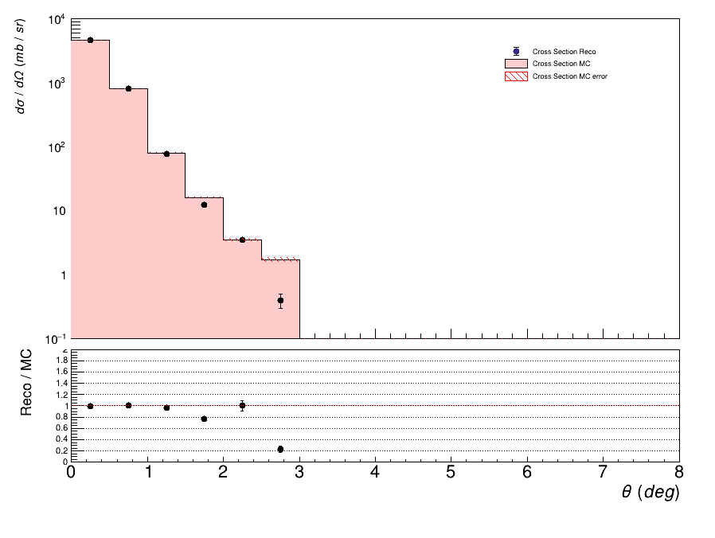
MC Closure test - angular differential cross section
1.4
1.4
1.4
1.4
1
1
1
1
0.6
0.6
0.6
0.6
Z=1
Z=2
Z=3
1.4
1.4
1.4
1.4
1.4
1.4
1.4
1.4
1
1
1
1
1
1
1
1
0.6
0.6
0.6
0.6
0.6
0.6
0.6
0.6
8
Z=4
Z=5
Z=6
Z=7

Slide 15
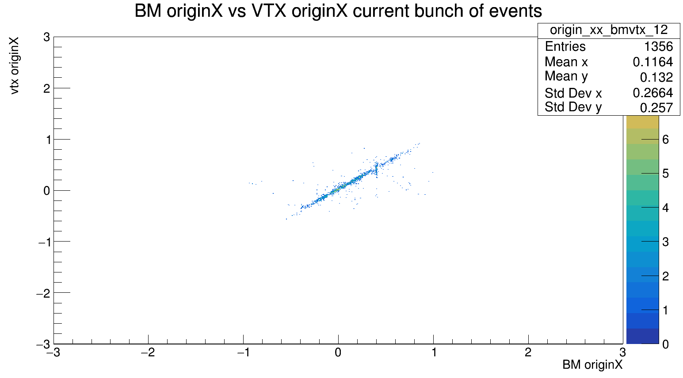
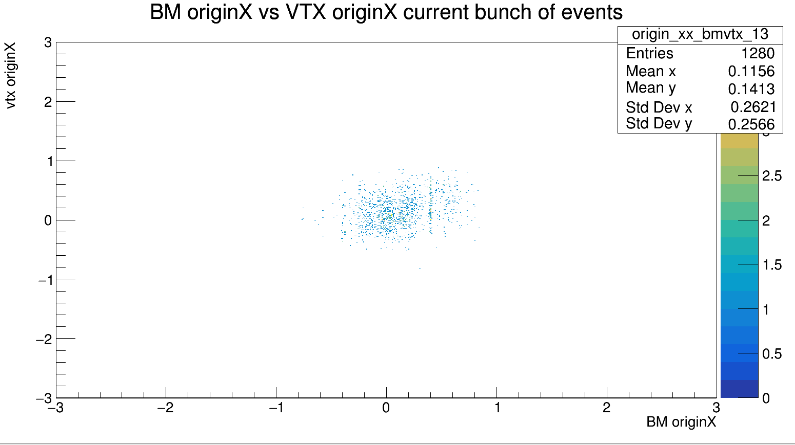
Experimental data
run 4306 (Minimum Bias)
Vertex synchronization up to 65k events:
Bm-vtx correlation up to 65 k evts
Bm-vtx correlation from 65k to 75 k evts
9
XIII FOOT Collaboration Meeting

Slide 16
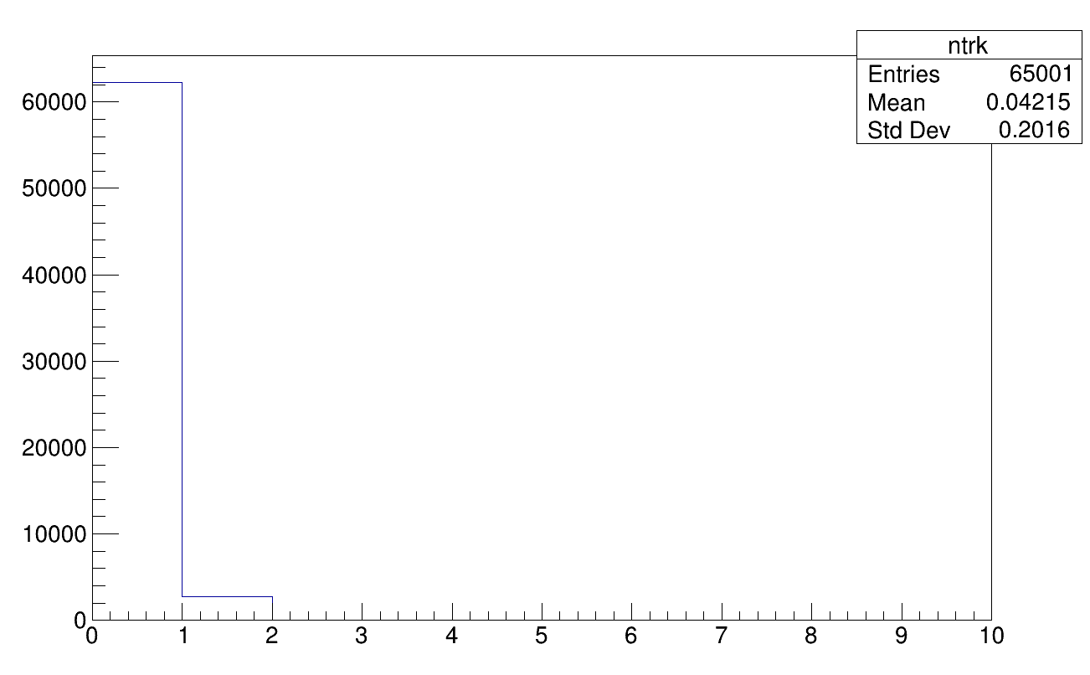
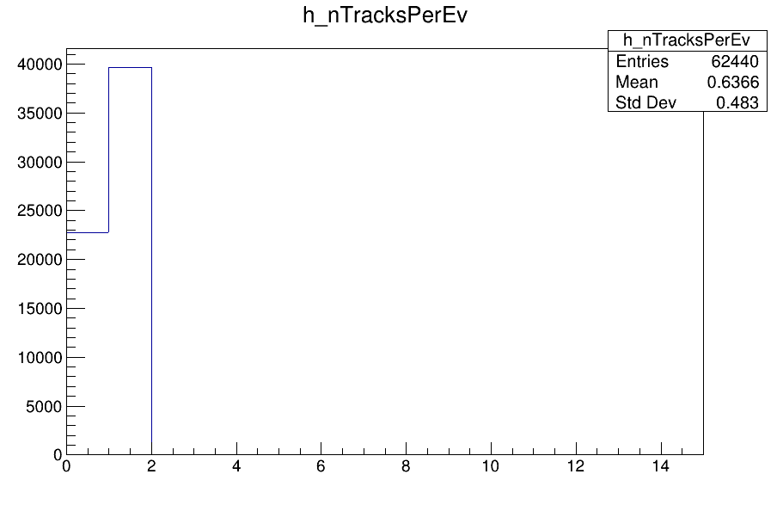
Alignment
Very low inefficiency in tracking reconstruction
AlignFOOTMain.C
Only 3% of events reconstructed with > 1 track
More than 60% of events reconstructed with > 1 track
10
XIII FOOT Collaboration Meeting

Slide 17
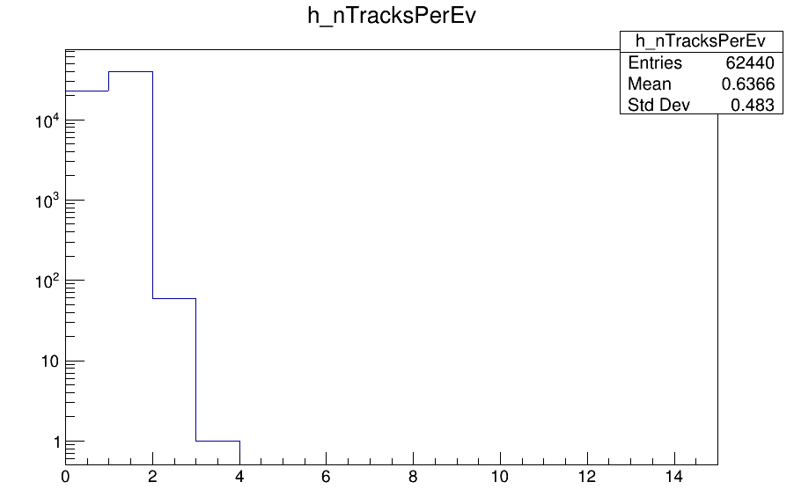
Alignment
Very low inefficiency in tracking reconstruction
AlignFOOTMain.C
Only 3% of events reconstructed with > 1 track
More than 60% of events reconstructed with > 1 track
10
XIII FOOT Collaboration Meeting

Slide 18
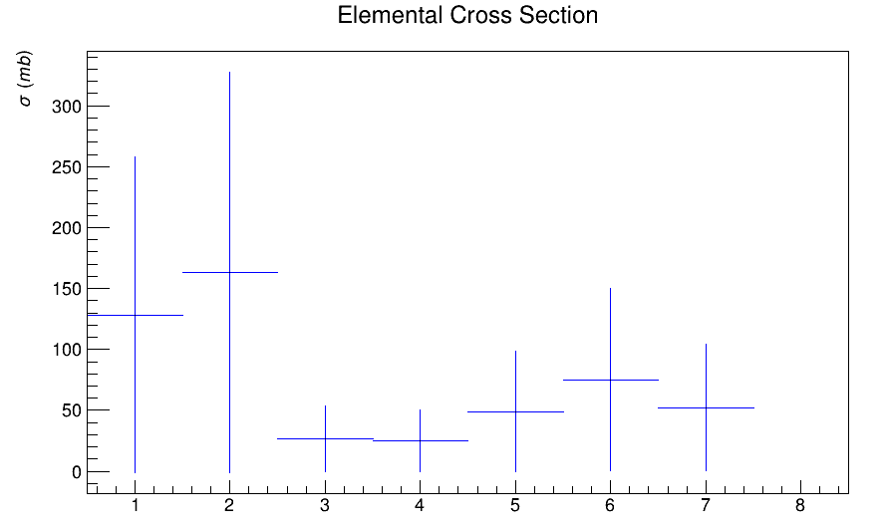
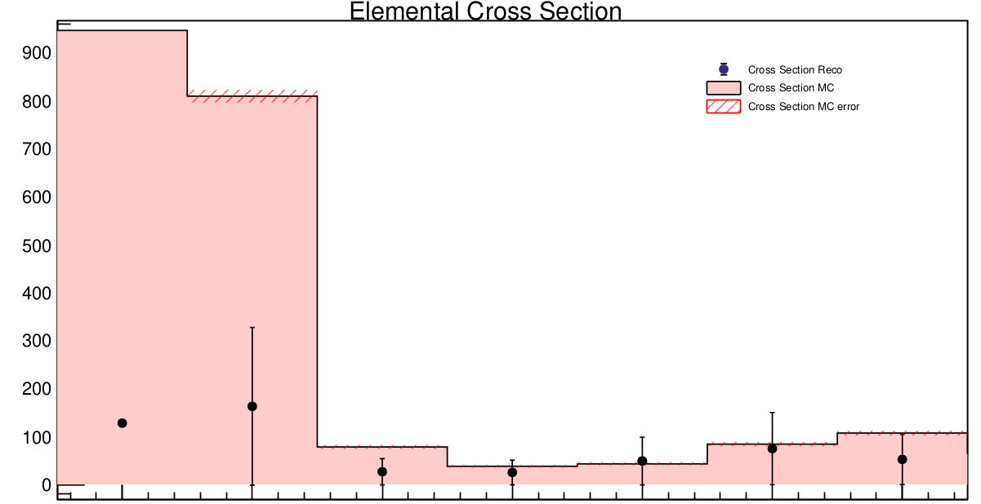
Experimental results - elemental cross section
experimental results
experimental results and comparison with MC
Z
1 2 3 4 5 6 7
Z
Highest discrepancy for elements with high angular distribution (see next)
11
XIII FOOT Collaboration Meeting
Giacomo Ubaldi

Slide 19
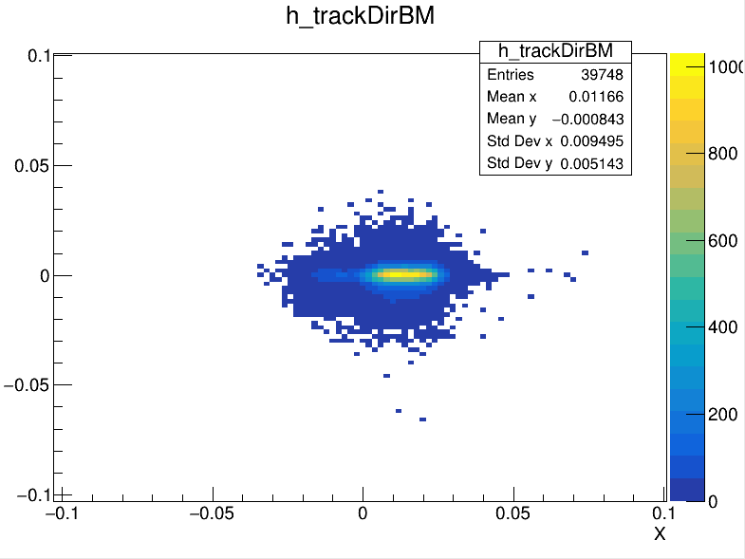
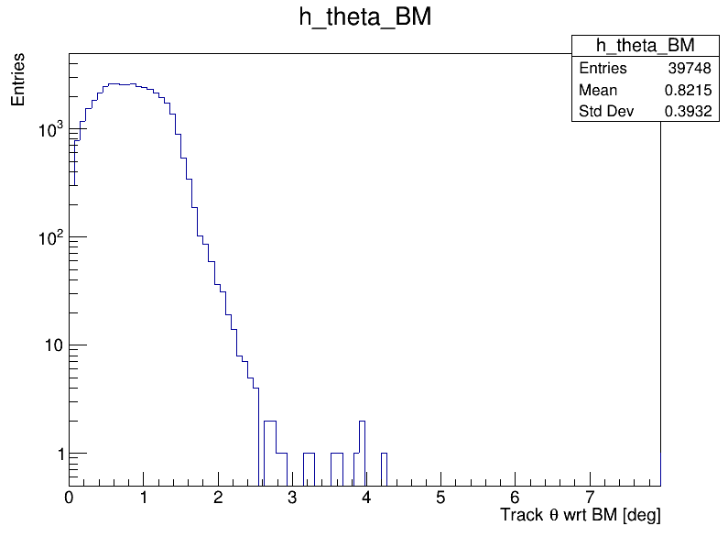
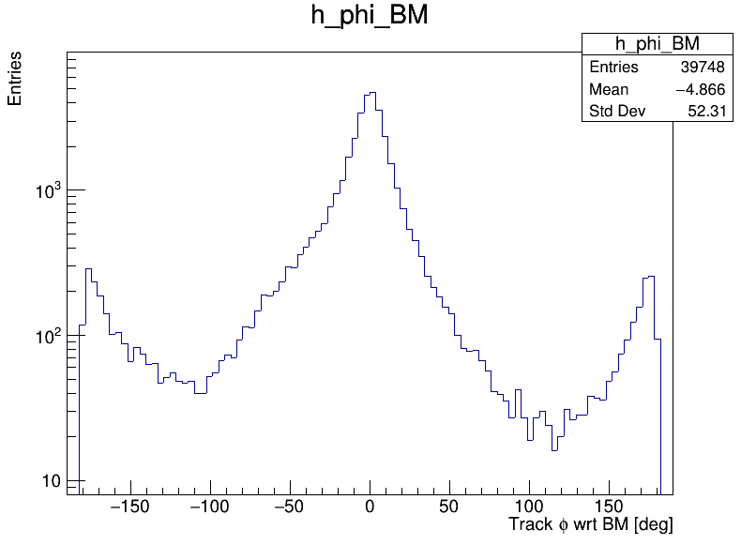
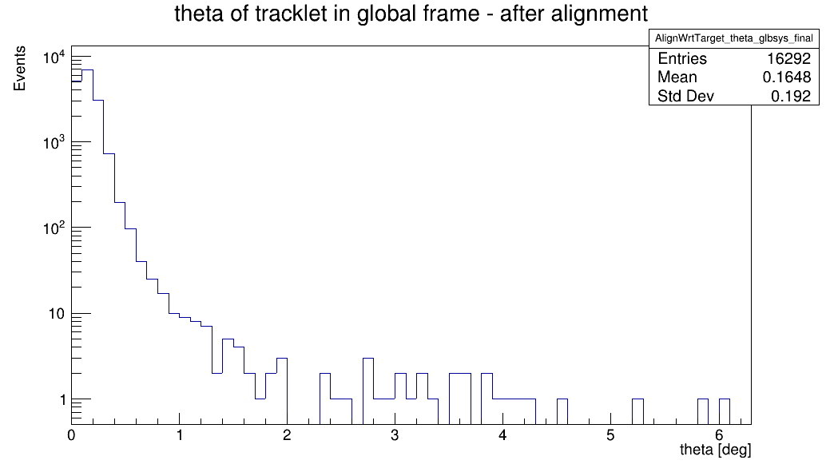
Alignment – global track
Reference system with beam (X,Y) in (0,0)
Global tracks XY profile
Global tracks theta angle
Global tracks phi angle
Shifted on X axis
It seems only “straight” tracks are reconstructed
Due to profile shape → favored direction
13
XIII FOOT Collaboration Meeting
Giacomo Ubaldi

Slide 20
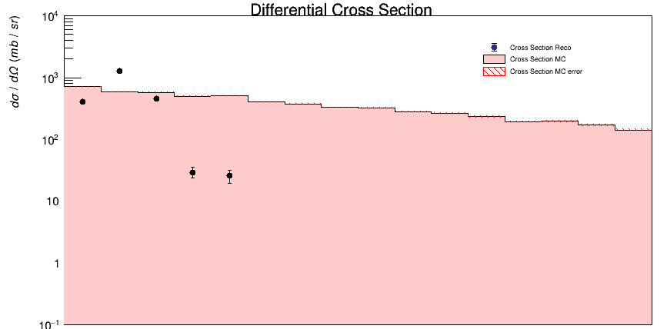
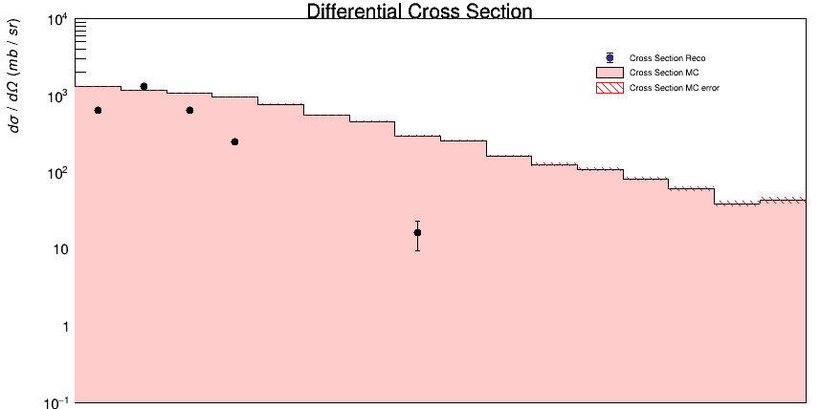
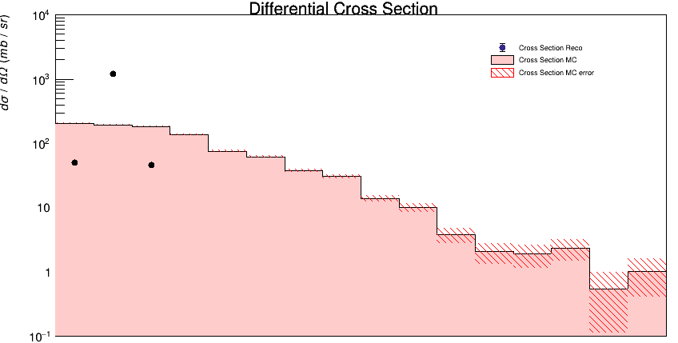
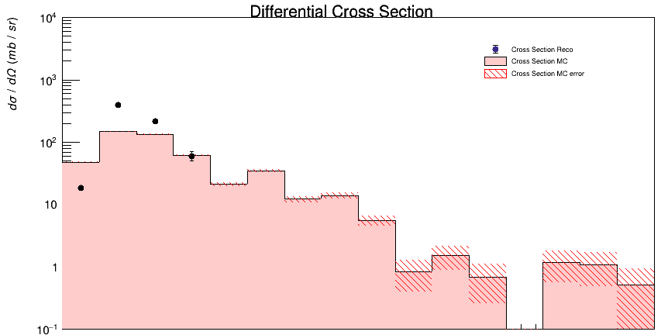
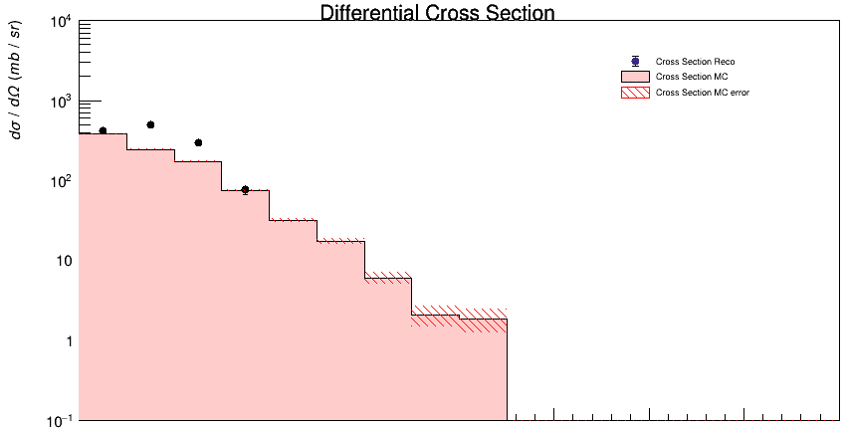
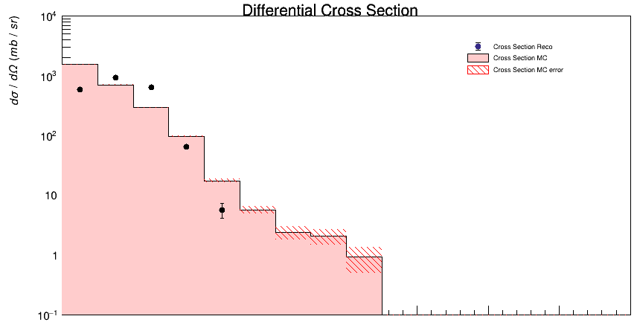
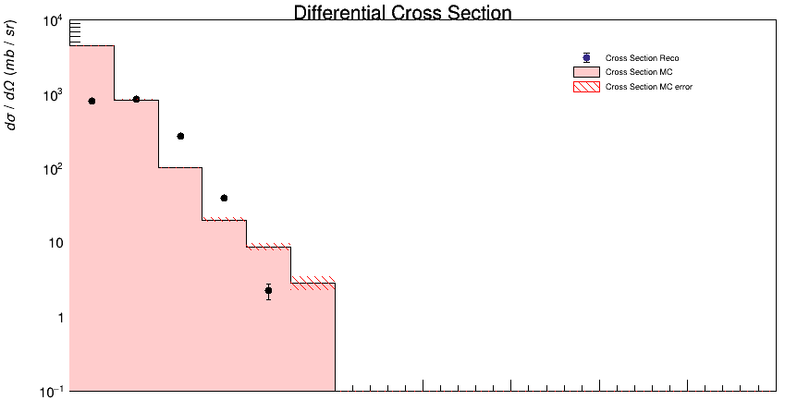
Experimental results - angular differential cross section
Z=1
Z=2
Z=2
Z=2
Z=2
Z=2
Z=3
Z=4
Z=5
Z=6
Highest agreement with high Z,
whose angular distribution is more
focalized around low angles
Z=7
12
Giacomo Ubaldi

Slide 21

Conclusions
Analysis strategy checked by MC events with a solid closure test
First preliminary results of experimental cross sections with full reconstruction algorithm
Future perspectives:
For the analysis:
Increase the statistics
Including systematic uncertainties
Including unfolding to correct for migrations
For the global tracking reconstruction:
Deeper studies about alignment and detector components
Thank you for the attention
14
XIII FOOT Collaboration Meeting
Giacomo Ubaldi

Slide 22
Backup slides

Slide 23
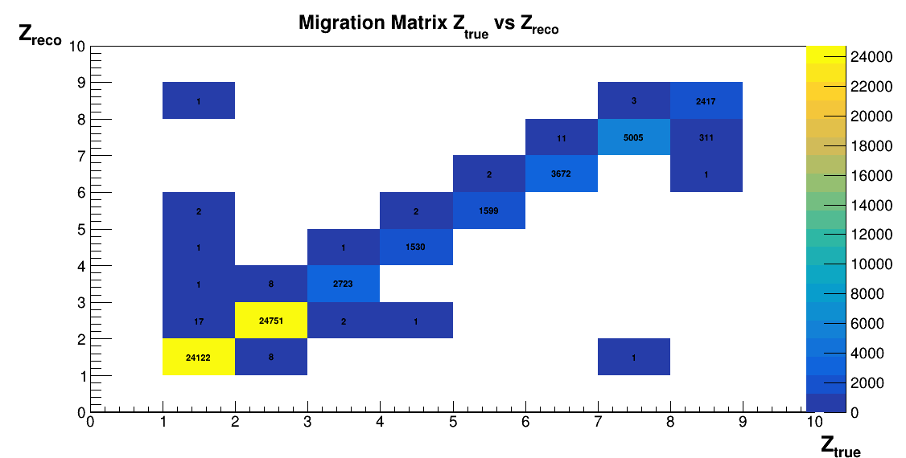
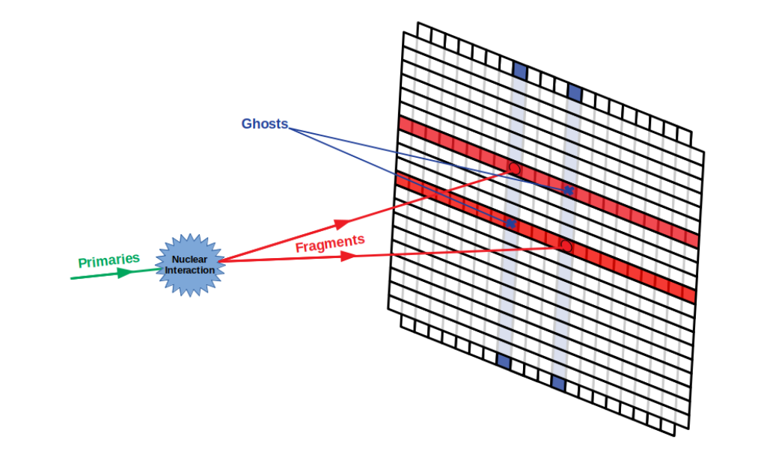
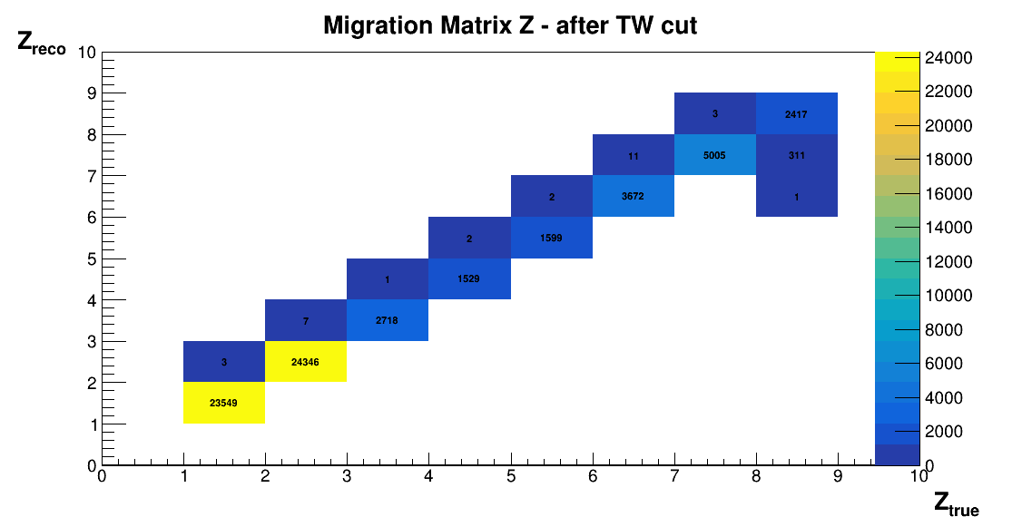
Example: Track reconstruction
It is possible that every bar layer of the TW is hit by more than a fragment at the same time:
multiple hits / ghost hits mis-reconstruction
TW
Applying TW cut:
Matrix more diagonal

Slide 24
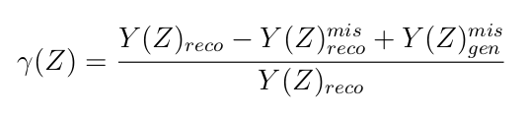
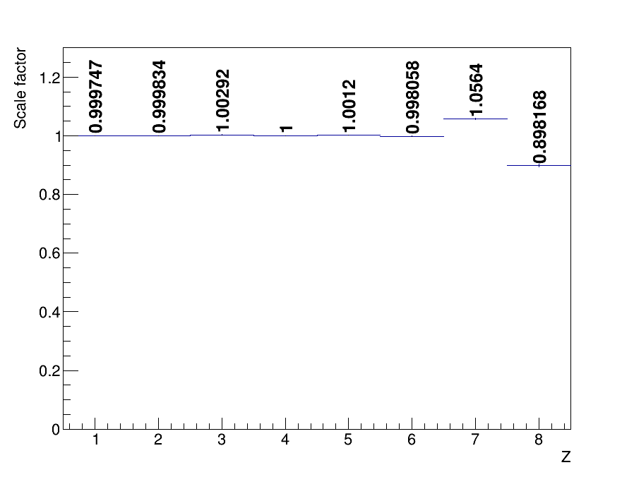
Analysis procedure
Migration matrix correction as
scale factor:
Giacomo Ubaldi

Slide 25
Reconstruction, Track Algo
Another source of systematics can be the way points are collected in a track
In the best scenario, all points belong to the same particle:
Reconstructed track:
x
x
x
x
x
x
x
x

Slide 26
Reconstruction, Track Algo
However, due to the presence of a lot of secondary fragmentation, some points can belong to other particles.
Reconstructed track:
x
x
x
x
x
x
x
x
Wrong points collected in the track
The McId of the track is given by the most present particle in the collection
However, if the TWPoint is of another particle → its McId is different
→ filter out all the tracks in which McId_{track} ≠ McId_{TWPoint}

Slide 27
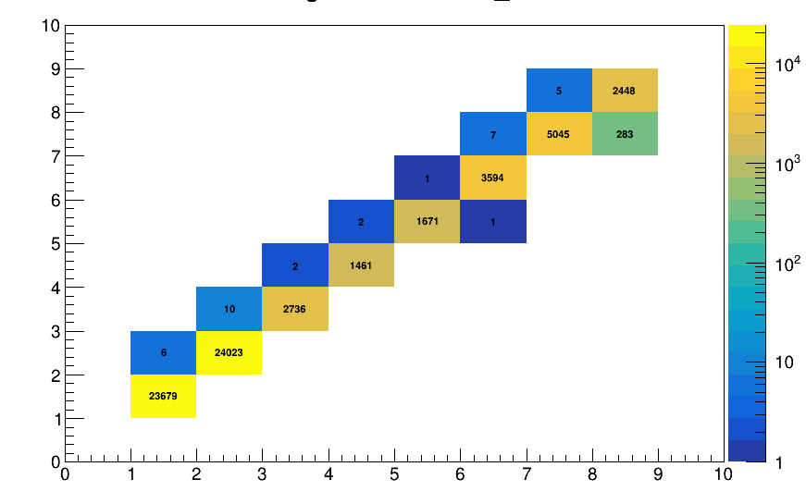
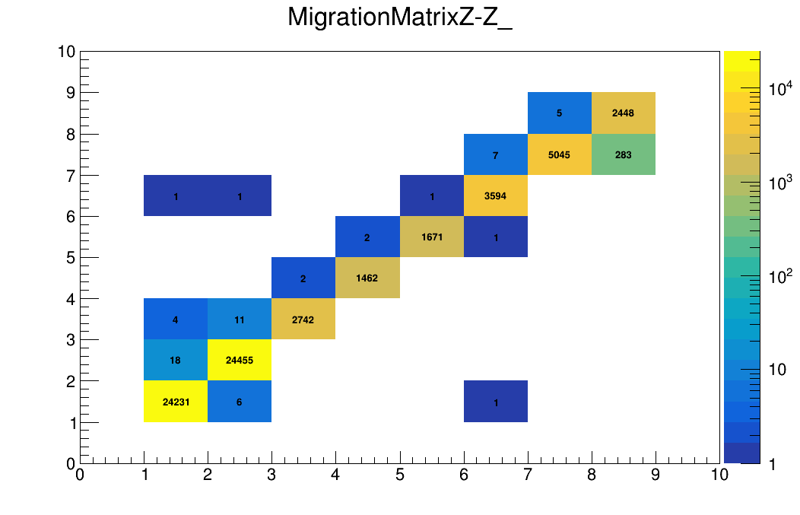
Analysis procedure
Before and after background removal: more diagonal migration matrix → less noise sources
Z_{reco}
Z_{reco}
Z_{true}
Z_{true}
4
XIII FOOT Collaboration Meeting
Giacomo Ubaldi

Slide 28
Backup slides

Slide 29
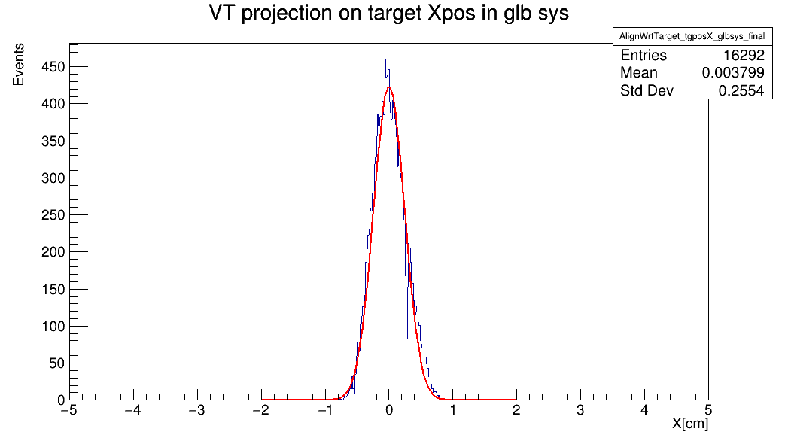
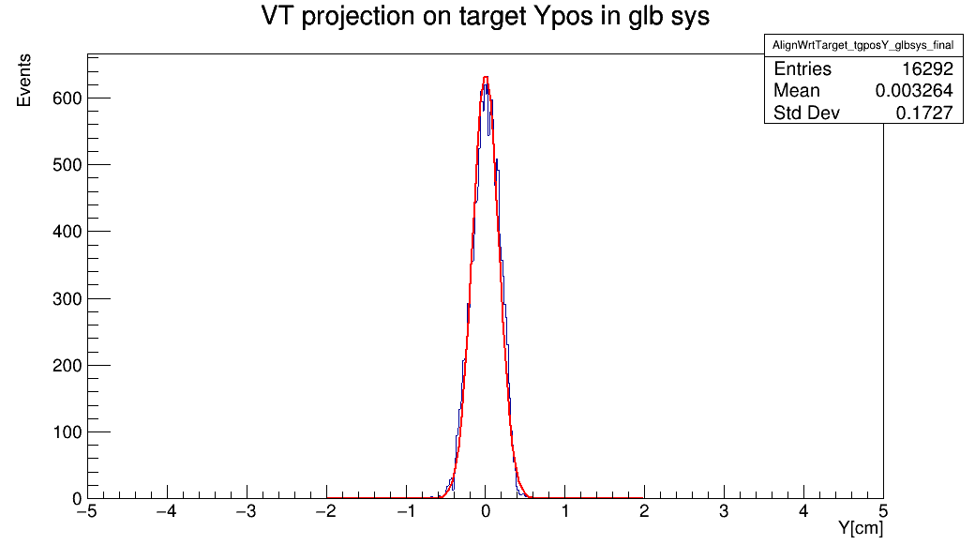
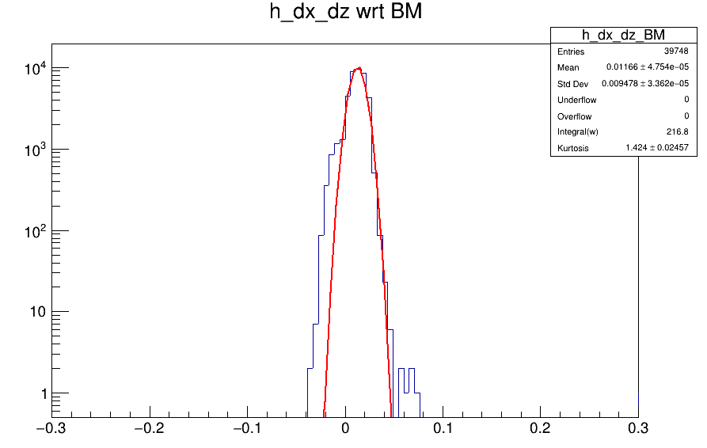

Alignment
VTX tracklets position wrt X,Y
Global tracks position wrt X,Y
  Shift on X of 0.01 cm

Slide 30



Alignment

Slide 31

Alignment events
VTX and MSD are
reciprocally tilted

Slide 32
Backup slides

Slide 33









MC Closure test - angular differential cross section
1.4
1.4
1.4
1.4
1
1
1
1
0.6
0.6
0.6
0.6
Z=1
Z=2
Z=3
1.4
z=8
1.4
1.4
1.4
1.4
1.4
1.4
1.4
1
1
1
1
1
1
1
1
0.6
0.6
0.6
0.6
0.6
0.6
0.6
0.6
9
Z=4
Z=5
Z=6
Z=7

Slide 34


Angular xsec, Z=1,2

Slide 35


Angular xsec, Z=3,4

Slide 36


Angular xsec, Z=5,6

Slide 37

Angular xsec, Z=7

Slide 38
Backup slides

Slide 39







FOOT Applications
Hadrontherapy treatments: up to 400 MeV/n
sparing of healthy tissues
Space radioprotection:
up to 800 MeV/n
shielding from charged
fragments in space
Charged particles interaction with matter:
Localized dose profile
Nuclear Fragmentation
1
Giacomo Ubaldi

Slide 40


The FOOT experiment
Goal:
Double differential nuclear fragmentation cross section with resolution better than 5%
Fixed target collisions
Beam energies between 200 MeV/u and 800 MeV/u for hadrontherapy and space radioprotection topics
table top setup to be moved according to beam facility availability
z
BEAM
2
Giacomo Ubaldi

Slide 41
The FOOT experiment
Goal:
Double differential nuclear fragmentation cross section with resolution better than 5%
Particle identification by measuring all kinematic quantities
Beam
monitor
Target
Start Counter
2
z
BEAM
Pre-target region
2
Giacomo Ubaldi

Slide 42
The FOOT experiment
Goal:
Double differential nuclear fragmentation cross section with resolution better than 5%
Particle identification by measuring all kinematic quantities
Vertex
Tracker
Inner
Tracker
Microstrip Silicon
Detector
z
BEAM
Permanent
Magnets
Tracking region
2
Giacomo Ubaldi

Slide 43
The FOOT experiment
Goal:
Double differential nuclear fragmentation cross section with resolution better than 5%
Particle identification by measuring all kinematic quantities
ToF Wall
Calorimeter
z
BEAM
Downstream region
2
Giacomo Ubaldi

Slide 44


Hadrontherapy
tumor
Hadrontherapy vs radiotherapy:
Finite range
Localized dose profile
Spare of healthy tissues
Nuclear Fragmentation
Giacomo Ubaldi

Slide 45



Space radioprotection
MARS

Slide 46
Space radioprotection
MARS
SOLAR RADIATION
suddenly
92% p
6% He
2% HZE
E<1 GeV/n

Slide 47

Space radioprotection
COSMIC RAYS
constantly
90% p
9% He
1% HZE
0.001 < E < 10¹⁴ GeV/n

Slide 48



Space radioprotection
MARS

Slide 49
Space radioprotection
MARS
fragmentation
Effects on:
- Space craft hull and structure
- Shielding
- Astronaut’s body

Slide 50
Space radioprotection
MARS
fragmentation
Dose equivalent
Dose
Fluence

Slide 51


Nuclear fragmentation
Proton beam:
~ 200 MeV
Target fragments:
Short range
High energy impact in entrance channel
Carbon beam:
Projectile fragments:
Longer range than beam
Dose beyond the Bragg peak
~ 400 MeV/u

Slide 52


Nuclear fragmentation
Proton beam:
~ 200 MeV
Carbon beam:
Projectile fragments:
Longer range than beam
Dose beyond the Bragg peak
~ 400 MeV/u
nuclear cross section
mesurements needed

Slide 53

GSI 2021 Analysis
Data-taking at GSI (Darmstadt, Germany) in 2021
¹⁶O 400 MeV/u and 200 MeV/u on 5 mm C target
Partial setup: no tracker, only one module of calorimeter
Specific goal:
Elemental (charge differential) fragmentation cross section
Angular charge double differential cross section

Slide 54

Differential Cross section
Yield of all fragments
Background
unfolding
efficiency
N° of primary
events
N° of scattered
centers
Phase space

Slide 55



Fragments identification
From Bethe – Bloch formula I can get z:
Infos taken from SC and TW
dE
z=8
z=7
z=6
z=5
z=4
z=3
z=2
z=1
ToF
Charge discrimination
TW charge reconstruction algo

Slide 56


Analysis procedure
4) Track efficiency obtained as:
where track is obtained by tracking algorithm
MC particles are from the generated simulation
Total Track efficiency
Fiducial Track efficiency
Giacomo Ubaldi

Slide 57

MC Closure test elemental cross section
understand the reliability of the analysis chain and algorithms
comparing the MC data-like cross sections with the MC generated ones.
Total cross section
Fiducial cross section
Giacomo Ubaldi

Slide 58









MC – Angular yields and Bkg
z=1
z=4
z=1
z=2
z=3
z=5
z=6
z=7
z=8

Slide 59








MC - Angular efficiencies
z=1
z=2
z=3
z=4
z=5
z=6
z=7
Giacomo Ubaldi
z=8

Slide 60

Kalman Filter
1. Take an ideal particle in vacuum. If we
add air + detector layers, trajectory
changes due to M.S. and energy loss.
2. We’ll see some measurement hits on
the detector layers (considering finite
detector uncertainty).
3. Propagate the first hit to the next
layer. Propagator Matrix F.
4. Find the best compromise between
the propagated point and the closest
hit on the 2 nd layer. Use a Chi2 and a
Projection Matrix H.
5. Iterate 3 and 4 for the next layers.

Slide 61



Track reconstruction
TW
MSD
VT
track reconstruction on GSI 2021 data
No B field present
Kalman Filter reconstruction of a track
Start from VT tracklets
Projection to possible planes of IT
KF extrapolation to MSD
KF extrapolation to TW
Fit the track candidates and extract reconstructed quantities: Z, momentum ...

Slide 62

Trigger Simulation
Fragment Trigger is fired every time Minimum Bias condition on TW is not verified

Slide 63

Trigger Simulation
Applying Trigger cut:
Z_{reco}
Z_{true}
Main source of mis-reconstruction is given by O due to its high statistics

Slide 64




Pile-up removal
What it was seen in the last data taking (GSI - CNAO 2021) is that the beam flux is not constant → pile-up events
2 crosses
4 crosses
constant
threshold
discrimination
method
2 crosses
4 crosses
Single projectile
Pileup projectile
Single projectile: 4 crosses
pileup projectile: >4 crosses

Slide 65


Pile-up removal
Both minimum bias trigger and trigger fragmentation
Charge
t(ns)
t(ns)
PileUp on 600.000 events ~ 1%

Slide 66






Isotopes identification
Mass reconstruction using all FOOT subdetectors:
In our data no tracker and calorimeter → mass measurement only in MC data!
Augmented Lagrangian Method
Aχ 2 = 11.66 ± 0.38
risoluz. 3.2 %
χ 2 < 5

Slide 67



Inverse kinematics

